Slide 1

DEPARTMENT OF ARTIFICAL INTELLIGENCE AND DATA SCIENCE
6th Sem Project Phase-1
“A Hybrid Neural Network for EEG-based Depression Screening Using CNN”
Project Team Members
Name USN
M.CHARAN 1SJ22AD024
B.LATHA SREE 1SJ22AD006
C S MOUNIKA 1SJ22AD008
Project Guide
Badrinath K
Assistant Professor

Slide 2

TABLE OF CONTENTS
  Problem Statement / Title
  Purpose, Scope, Objectives
  Abstract (System Overview)
  Introduction (Architecture and High-level Design)
  Literature Survey
  References
  Project Plan 1.0

Slide 3
PROBLEM STATEMENT:
Depression is a major mental health issue affecting over 322 million people worldwide, contributing to significant emotional, social, and economic burdens. Traditional methods for diagnosing depression, such as clinical interviews and self-reported questionnaires, are subjective and time-consuming. EEG-based diagnosis provides objective insights into brain activity but is prone to human error due to the complexity of interpreting EEG signals. Thus, there is a critical need for an automated and accurate depression screening system using EEG signals.

Slide 4
OBJECTIVES
Design a CNN-LSTM model to automate depression detection using EEG signals.
Improve adaptability using cross-validation and diverse datasets while employing regularization techniques like L2 regularization and adaptive learning rates.
Enhance model accuracy and generalization through techniques such as dropout, data augmentation, and early stopping.
Reduce computational complexity and latency for real-time depression screening on portable and cloud-based platforms.

Slide 5
PURPOSE
A fully automated, intelligent screening system is proposed for detecting depression using electroencephalogram (EEG) signals. By leveraging a hybrid deep learning architecture that combines Convolutional Neural Networks (CNN) and Long Short-Term Memory (LSTM) networks, the system enhances diagnostic accuracy while minimizing human intervention and computational overhead.

Slide 6
SCOPE
The system focuses on the development of a deep learning-based diagnostic tool that utilizes EEG signals for the automated identification of depressive disorders. It covers the entire pipeline—from signal acquisition and preprocessing to model training, evaluation, and integration into a deployable framework suitable for clinical environments or mental health screening platforms.

Slide 7
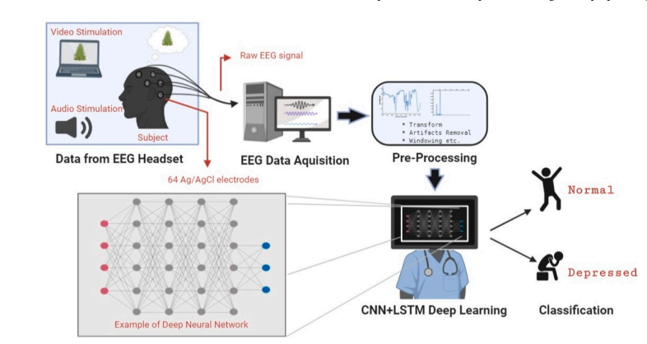
ABSTRACT
This project introduces DepHNN(Depression Hybrid Neural Network), a hybrid deep learning model for automated depression detection using EEG signals. Combining Convolutional Neural Networks(CNN) for local feature extraction and Long Short-Term Memory (LSTM) for sequential modeling, the system employs a windowing technique to boost efficiency. Tested on a dataset of 45 subjects, DepHNN achieved 99.1% accuracy, showing strong potential for non-invasive, real-time clinical screening of depression.

Slide 8
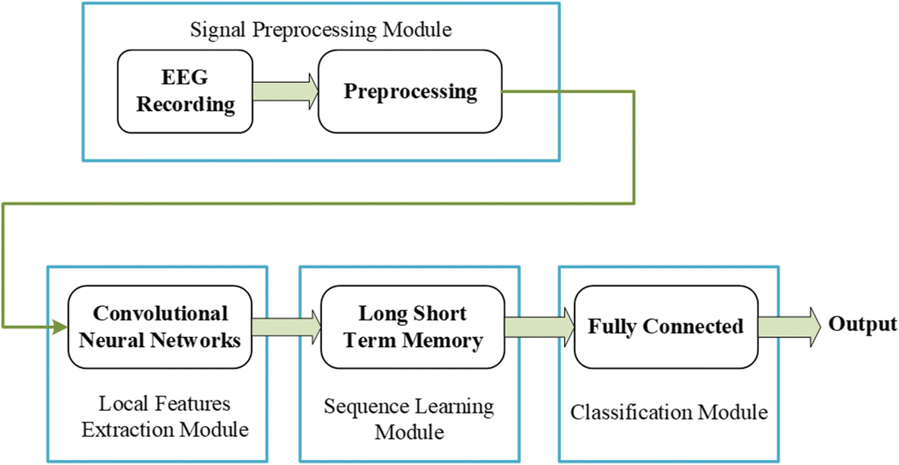
INTRODUCTION
Global Impact: Depression affects over 322 million people worldwide.
Challenge: Traditional diagnosis (interviews, questionnaires) is subjective and slow.
Solution: DepHNN, a non-invasive EEG-based AI system combining CNN (Local feature extraction) and LSTM (temporal pattern learning).
Function: Automatically processes EEG data to classify individuals as depressed or healthy.
Goal: Deliver a fast, robust tool to support timely, accurate clinical screening

Slide 9
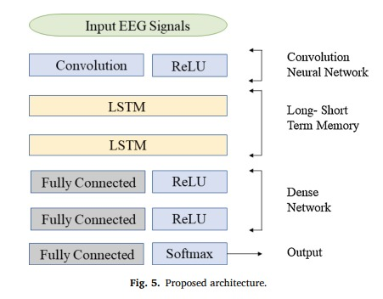
ARCHITECTURE

Slide 10
LITERATURE SURVEY
Author(s) | Research Paper Title | Advantages | Disadvantages | Implementation in Project
A. Seal | DeprNet: A Deep Convolution Neural Network Framework for Detecting Depression Using EEG | High accuracy with CNNs; Effective feature extraction | High model complexity; requires large training data | Inspired the CNN-based feature extraction in DepHNN
Z. Wan | HybridEEGNet: A Convolutional Neural Network for EEG Feature Learning and Depression Discrimination | CNN efficiently learns complex EEG features; Good generalization | Needs optimization for small datasets | Supports the hybrid model concept (CNN + sequence learning)
S. Sun | EEG-Based Depression Recognition by Combining Functional Brain Network and Traditional Biomarkers | Enhances detection with connectivity features | Moderate performance; complex preprocessing needed | Highlights combination of local and global feature learning
A. Sekhar | Performance Evaluation of LSTM Models in Detection of Depression from EEG Signals | LSTM captures sequential dependencies effectively | Needs careful tuning; high computational load | Justifies the use of LSTM layers in DepHNN

Slide 11
REFERENCES
RESEARCH PAPERS:
CNNs for EEG Signal Classification: “Convolutional Neural Networks for EEG Signal Classification: A Survey”
Depression Detection Using EEG and Deep Learning: “EEG-based Depression Detection Using Deep Neural Networks”
Combining CNN and LSTM for EEG-based Classification: “Hybrid CNN-LSTM Architecture for EEG-Based Human Activity Recognition”
Deep Learning for Mental Health Diagnostics: “Deep Learning for Depression Detection: A Survey”
WEBSITES: https://www.geeksforgeeks.org/introduction-convolution-neural-network/,
https://www.analyticsvidhya.com/blog/2021/03/introduction-to-long-short-term-memory-lstm/

Slide 12
PROJECT PLAN 1.0
Dataset Collection & Pre-processing:
  Activities:
  Obtain EEG datasets.
  Perform artifact removal using ICA (Independent Component Analysis).
  Apply windowing techniques for data segmentation.
  Deliverables:
  Clean, preprocessed EEG dataset.
Model Architecture Design:
  Activities:
  Build Convolutional Neural Network (CNN) layers for feature extraction from EEG data.
  Integrate Long Short-Term Memory (LSTM) layers for sequential learning and temporal pattern recognition.
  Deliverables:
  Completed hybrid CNN-LSTM model architecture.
Model Training:
  Activities:
  Train the model using 70% of the dataset.
  Use Adam optimizer for gradient-based optimization.

Slide 13
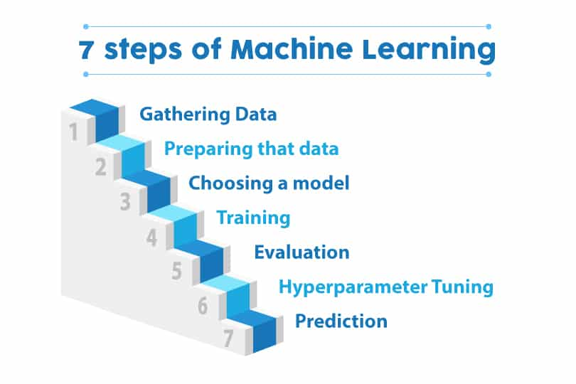
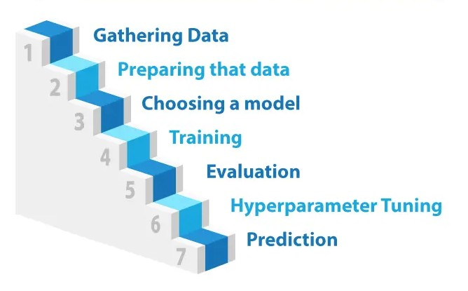
  Implement Huber loss as the loss function.
  Apply validation using 20% of the dataset.
  Deliverables:
  Trained model weights and training logs.
Hyperparameter Tuning:
  Activities:
  Tune hyperparameters such as learning rate, batch size, and window size.
  Optimize kernel sizes and LSTM units for better performance.
  Deliverables:
  Optimized model with maximum accuracy.
Model Evaluation:
  Activities:
  Test the model on 10% unseen data.
  Generate accuracy, Mean Absolute Error (MAE), and confusion matrix to evaluate model performance.
  Deliverables:
  Final model evaluation report (expected accuracy >98%).

Slide 14


